Slide 1
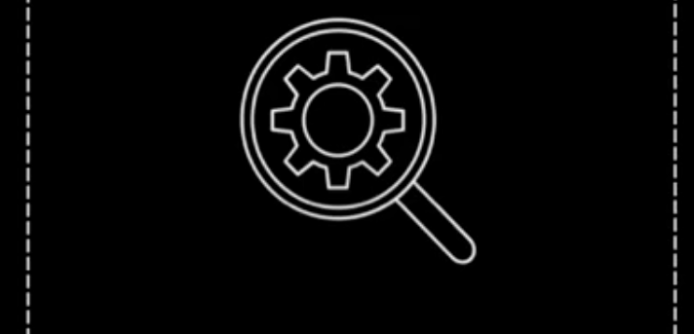
Analyze

Slide 2

Agenda
Identify how you can analyze data in IBM Cloud Pak for Data
Analyze data using notebooks Identify other tools that you can use to analyze data
Automatically analyze your data using the AutoAI tool
Deploy machine learning (ML) models

Slide 3
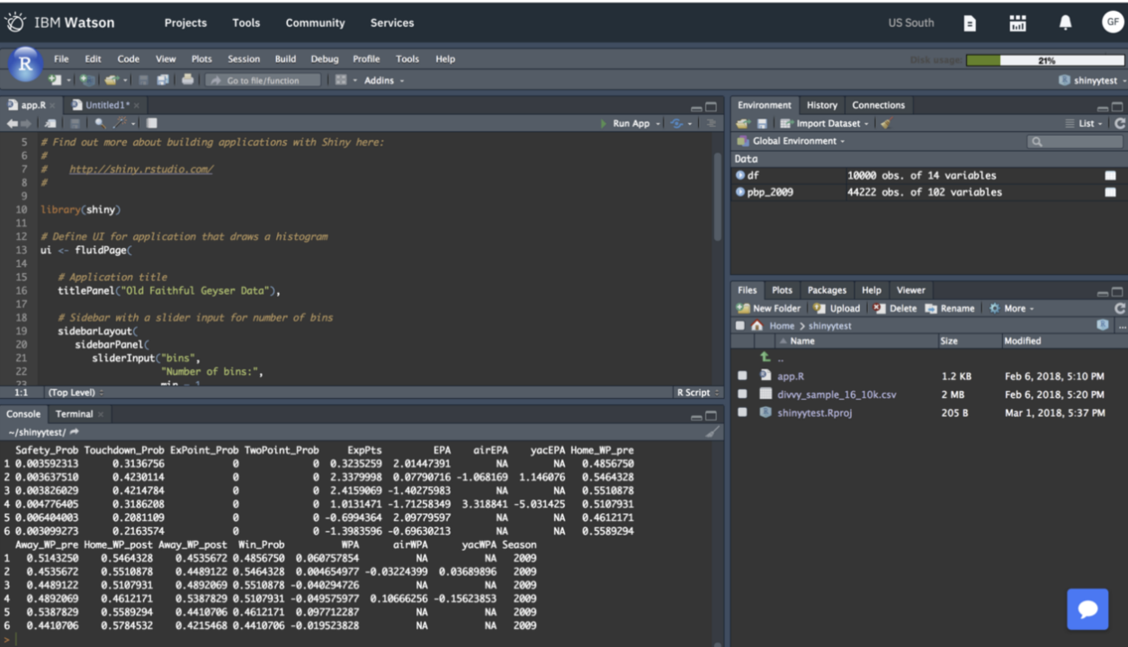
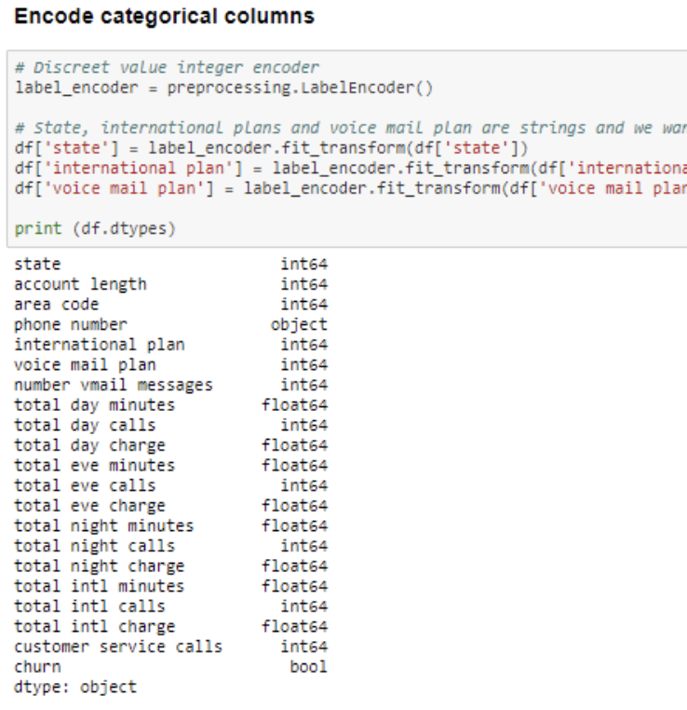
Programmatic Manipulation
Jupyter Notebooks and RStudio
Python, Scala and R
Use / Install open source libraries
Data structure/manipulation: Pandas, Numpy
Visualizations: Matplotlib (most popular),Brunel, seaborn, bokeh. Plotly, ggplot, pygal, PixieDust, etc
Algorithmic: SciPy (integrals, cals), Scikit-learn, Statsmodels, etc

Slide 4
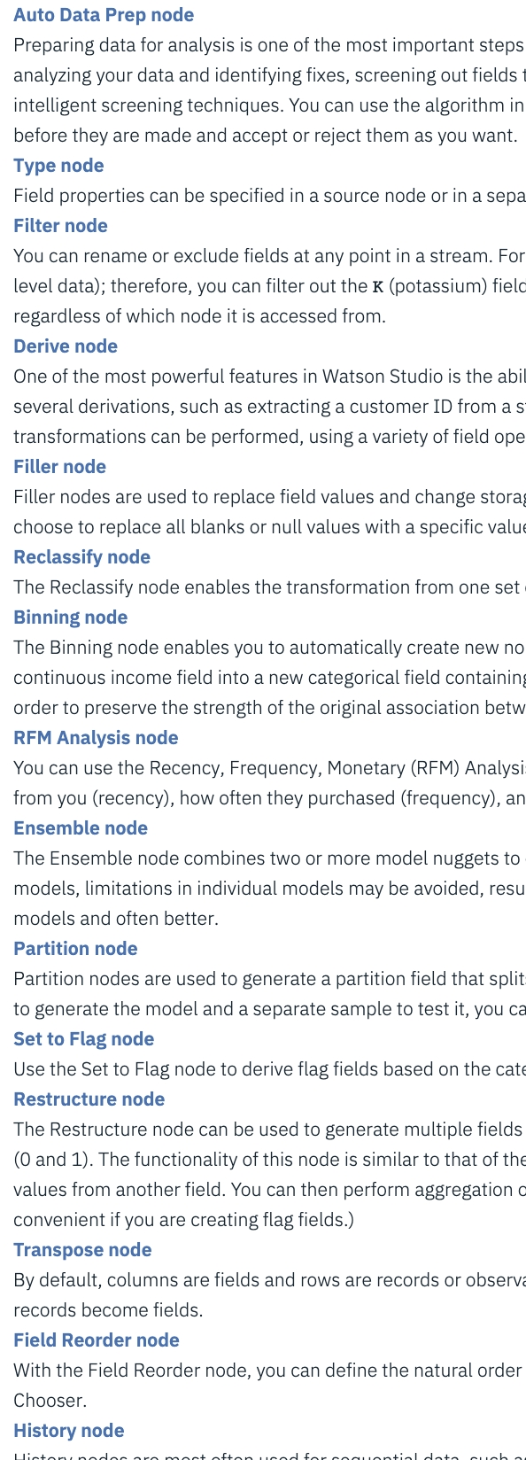
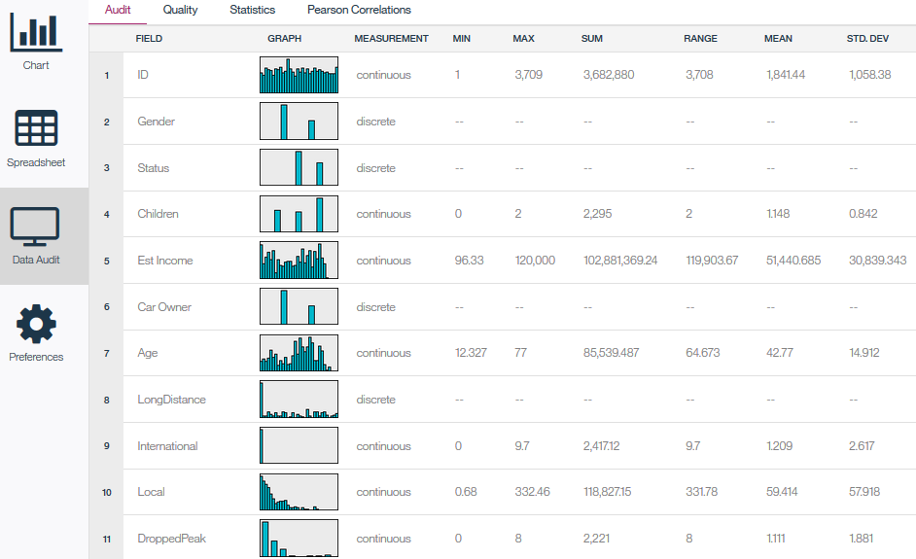
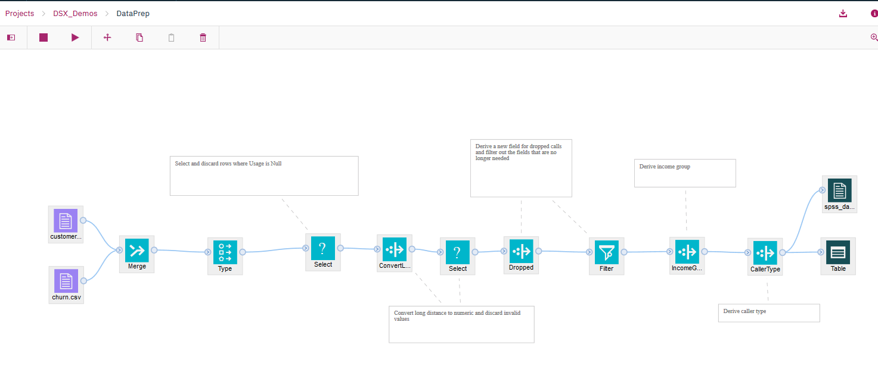
SPSS Modeler
Cleansing: fix or remove data that is incorrect, incomplete, improperly formatted, or duplicated
Shaping: customize data by filtering, sorting, combining, or removing columns, and performing operations
Visualization, statistics and processing
Original data set is not modified, changes pushed to output file or data source
Notes:
The flow can also run as a batch job

Slide 5
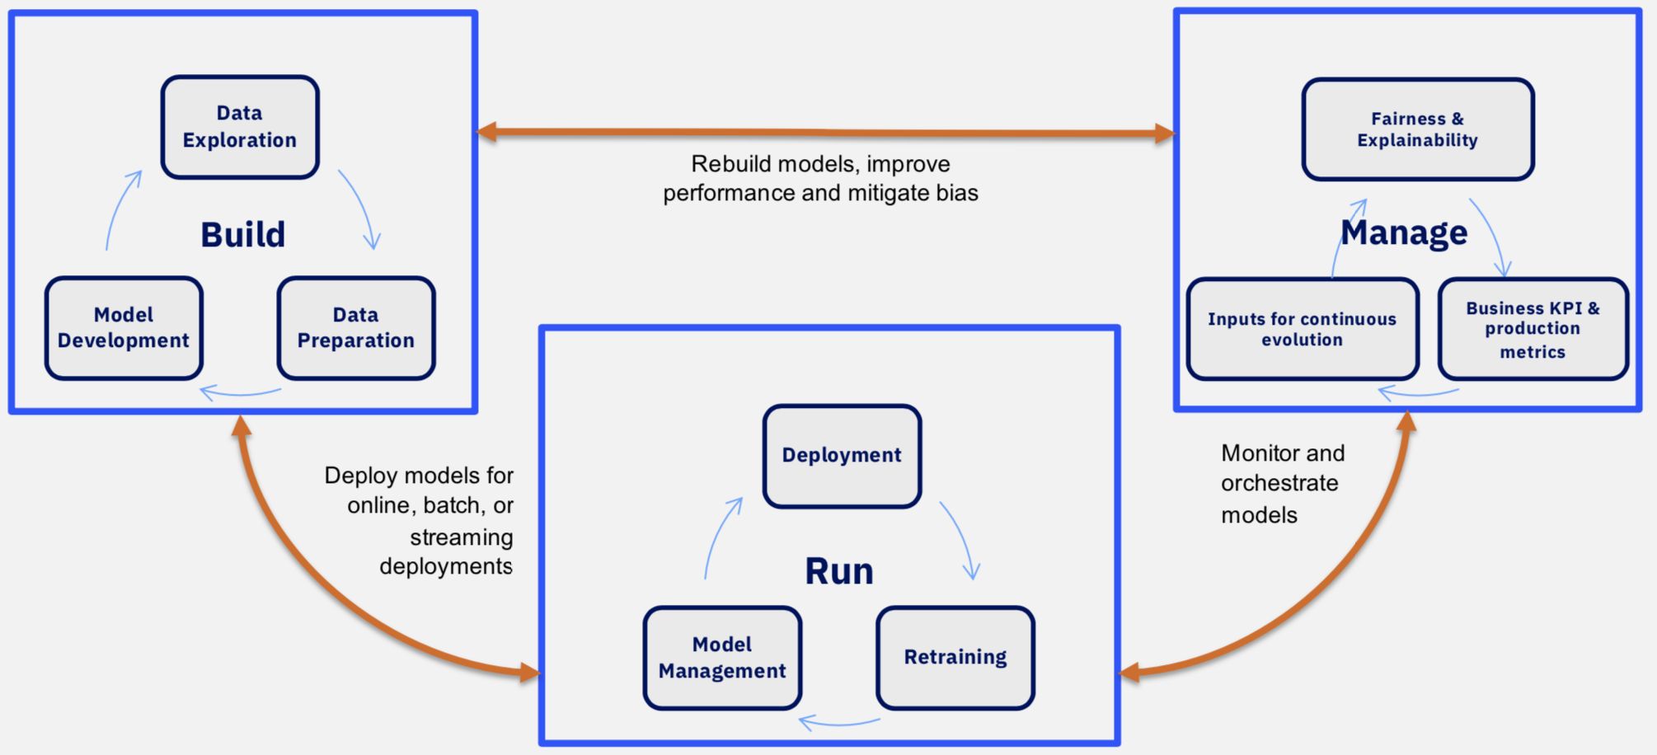
Data & AI Workflow
IBM Cognitive Applications © 2019 IBM Corporation

Slide 6
Machine Learning (ML) Overview

Slide 7
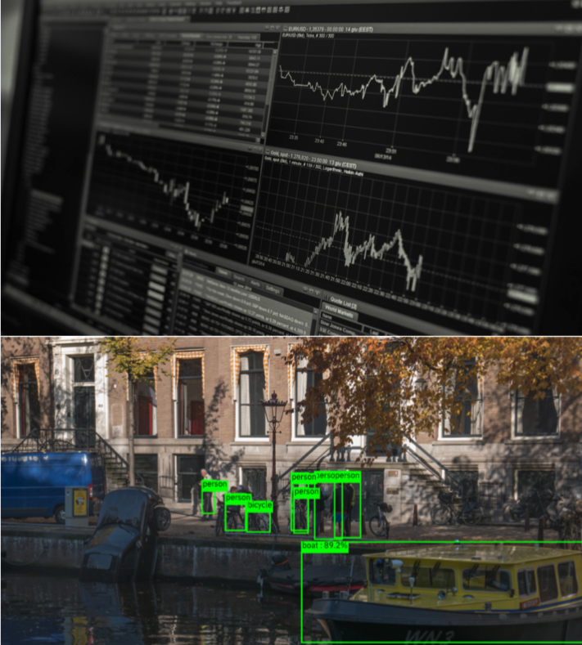
What is Machine Learning ?
“A computer program is said to learn from experience E with respect to some task T and some performance measure P, if its performance on T, as measured by P, improves with experience E.” -- Tom Mitchell, Carnegie Mellon University
Learn from data to make predictions
Computers apply statistical learning techniques to identify patterns in data and make predictions.
Learn from historical data to make predictions about the future
Use example data or past experience to solve a given problem.
Applied Machine Learning seeks to learn from historical data to make predictions about the future, in order to make decisions
Credit: Nick Pentreath Principal Engineer, IBM Center for Open-Source
Data & AI Technologies
Notes:
ML is never to make “perfect” guesses, the goal is to make guesses that are good enough to be useful.

Slide 8
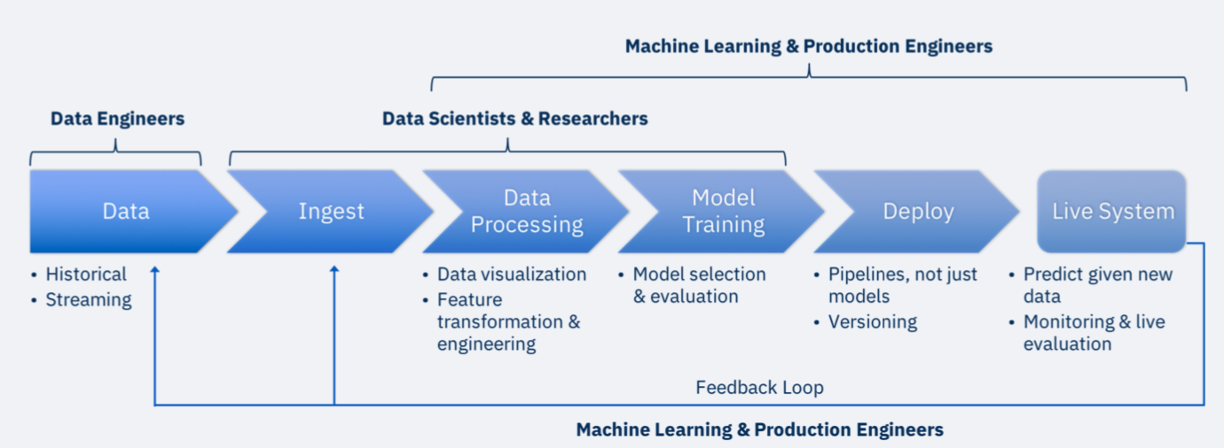
Machine Learning Across Teams
Credit: Nick Pentreath Principal Engineer, IBM Center for Open-Source
Data & AI Technologies
IBM Cognitive Applications © 2019 IBM Corporation

Slide 9
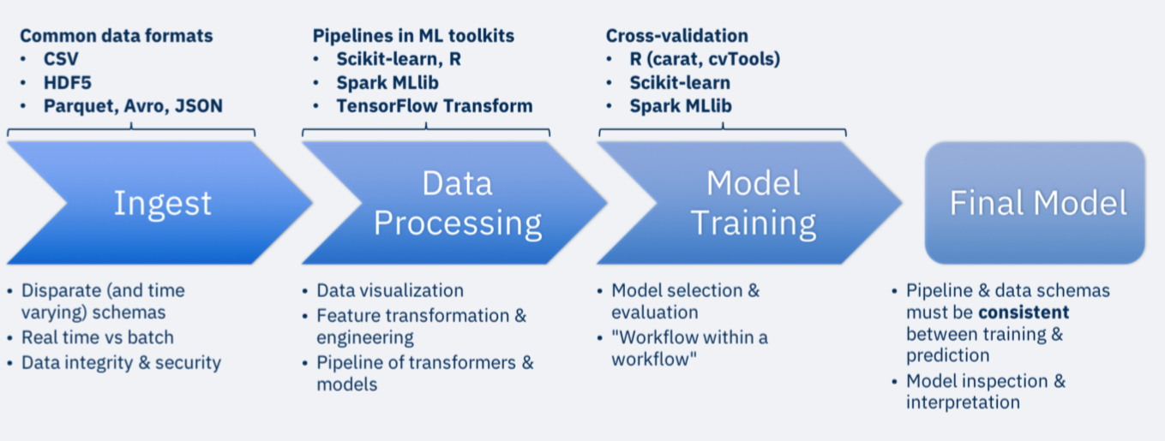
… tools
Credit: Nick Pentreath Principal Engineer, IBM Center for Open-Source
Data & AI Technologies
IBM Cognitive Applications © 2019 IBM Corporation

Slide 10
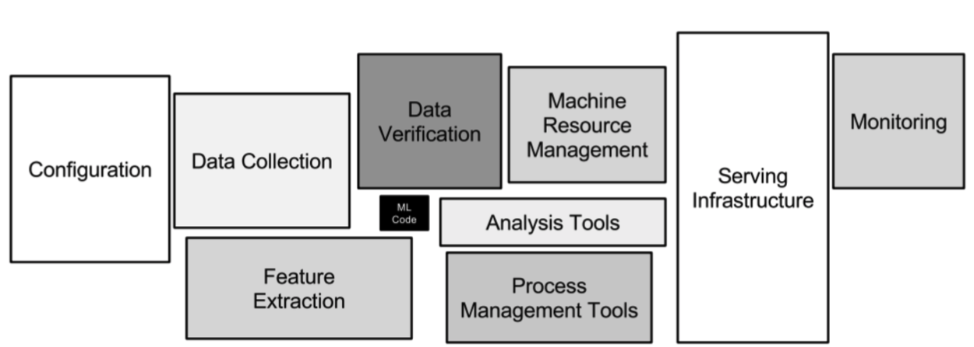
Just one piece of the puzzle
Reference
IBM Cognitive Applications © 2019 IBM Corporation

Slide 11
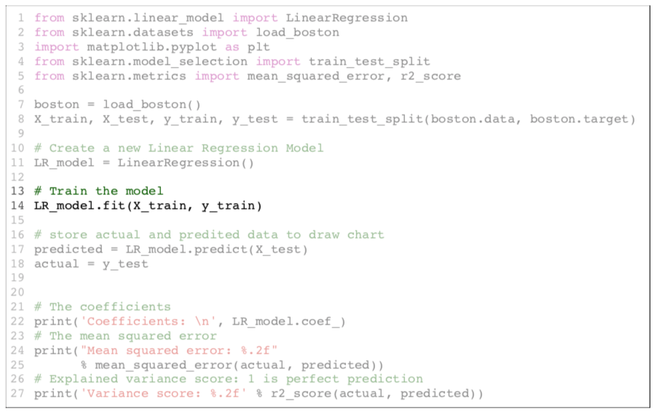
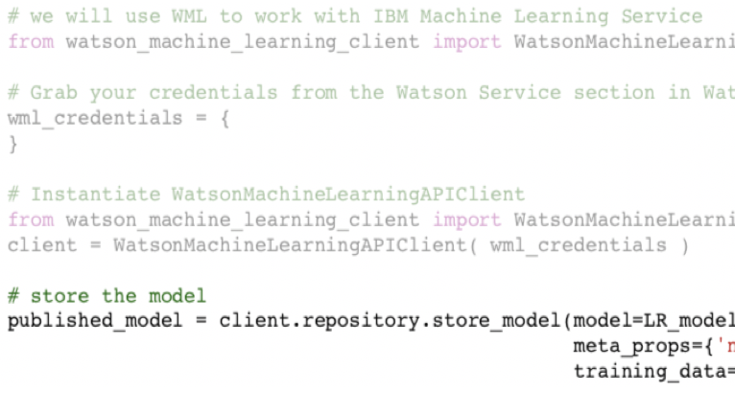
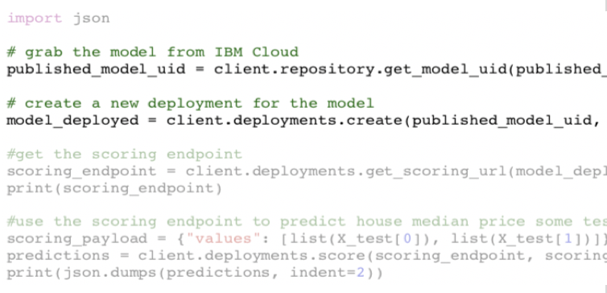
Example Linear Regression
IBM Cognitive Applications © 2019 IBM Corporation

Slide 12

ML Model Building and Deploying

Slide 13
Andreas Mueller – ML workflow graph

Slide 14
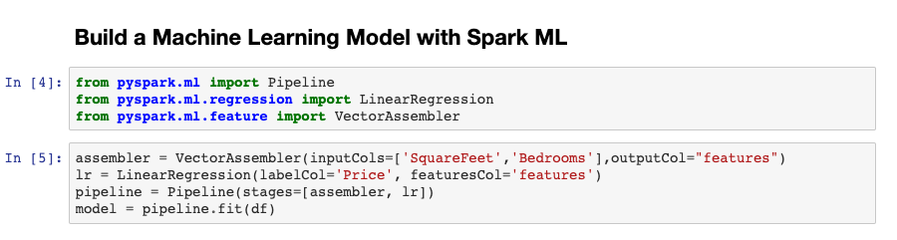
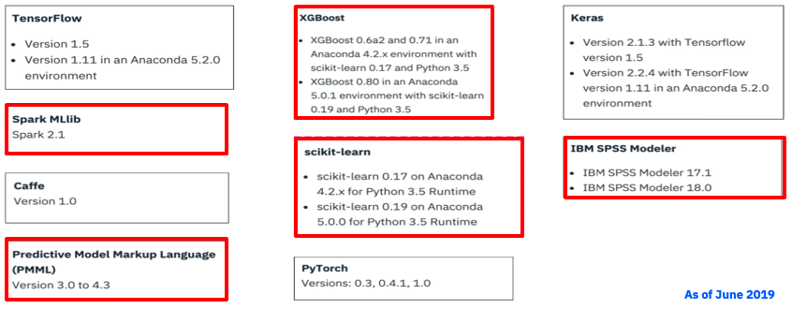
Code / Notebook
Anaconda based default or customized environments for Python (3.5) and R
Use Spark environment for Scala
Don’t forget : File → Stop Kernel
Notes:
Can use SPSS libraries in code (outside modeler). Only runs in IBM Analytics Engine Spark (not the default spark environment)
Python 2.7 requires custom environment
All default environment runtimes are shutdown automatically if they have been idle for longer than one hour.

Slide 15
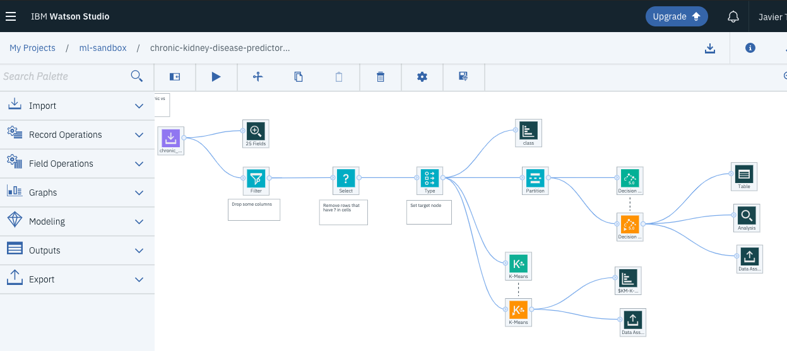
Visual Assembly
Drag and Drop visual assembly of pipelines using either SPSS Modeler runtime or Spark.
Data asset nodes to bring in data
Data preparation nodes to modify data (or use auto data prep node)
Modeling nodes to develop models (decision trees, random forest, linear regression ,etc).

Slide 16
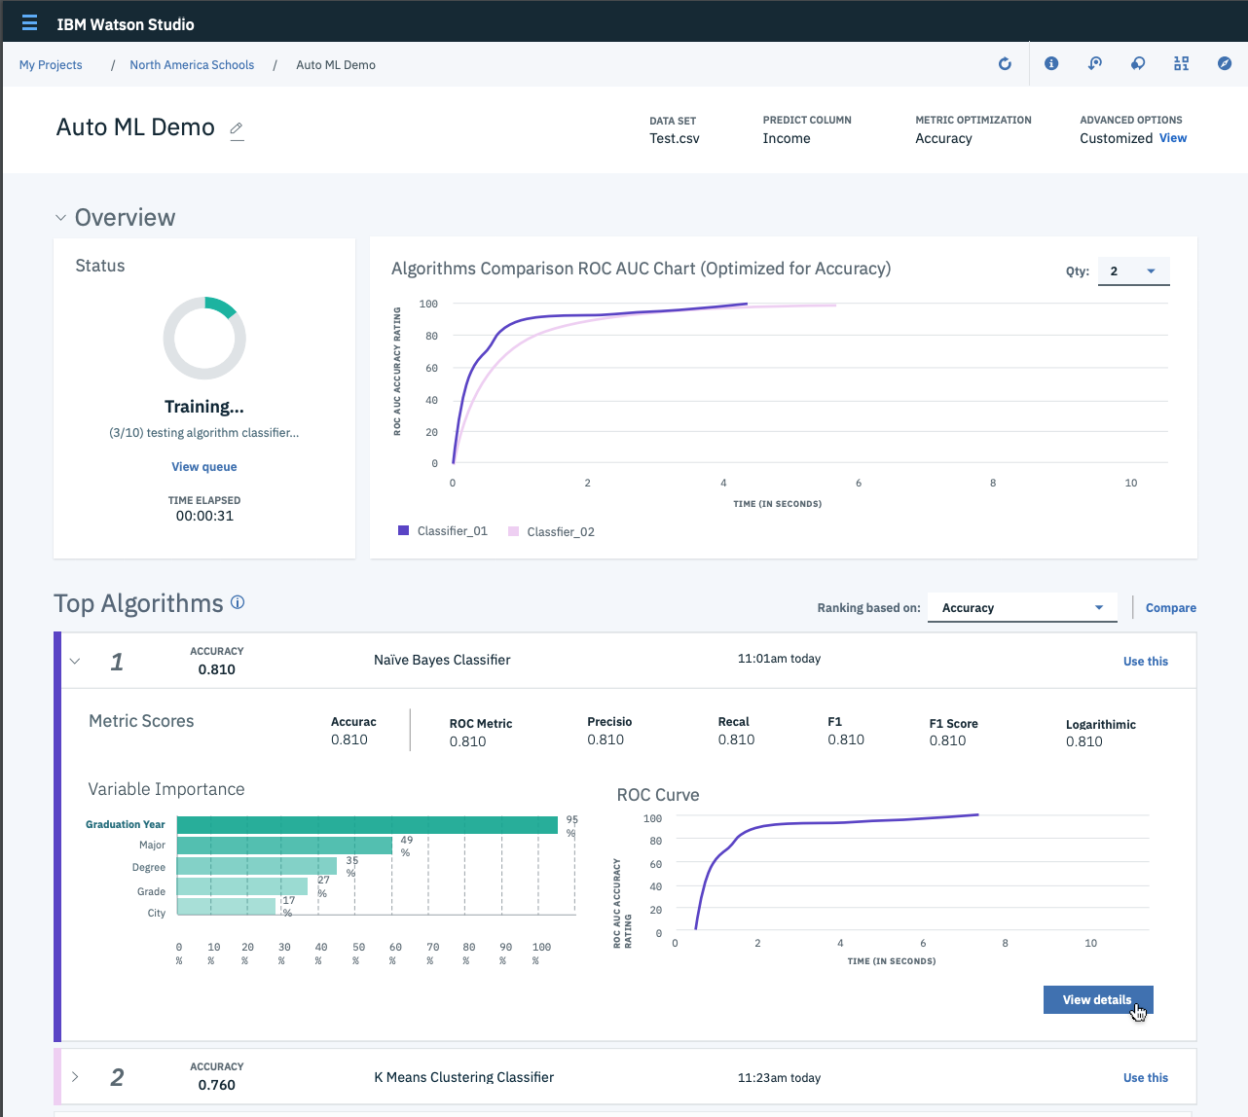
AutoAI
Encompasses three approaches to simplify model creation:
Transfer knowledge learning in one deep learning system to apply to a different domain (Watson Services)
AutoAI Pipeline Optimization to auto clean data, engineer features, and complete HPO to find the optimal end to end pipeline
Neural Network Search to generate custom deep neural network through searching the best architectures for the input data.
Training feedback visualizations provide real-time results to see model performance
One-click deployment to Watson Machine Learning
Notes:
For more background on AutoAi – It’s important to understand the range of capabilities people think of under this term.
First transfer learning is used most often with Deep Learning models typically with natural language or image processing applications. This functionality is available through Watson services like Visual Recognition and Natural language classifier – there is even tooling built for transfer learning in Watson Studio
Neural Network Search is also focused on Deep Learning, this time it automatically builds a neural network from scratch without needing to do any coding. This was made available as part of Watson OpenScale the end of last year and is now available in Beta
AutoAI Pipeline Optimization – is the focus of what we’ll be announcing next week at Think. This applies to traditional machine learning problems with structured data and automatically does the typically manual process of cleaning and transforming data, then searching for the best model with the best hyper parameters
These three areas of AutoAI currently exist in separate offerings from IBM but we are all working together for how these can best be integrated so that we have the overall best in breed capabilities for AutoAI

Slide 17
AutoAI: How does it work ?
Raw Labeled Data Set
Prep
Model selection
HPO
Feature Engineering
HPO
Ensembling
Finds best preprocessing imputation / encoding and scaling strategies
Finds top-K estimators
HPO on selected estimator
Finds best data transformation sequence
HPO on estimator after Feature Engineering
Computes ensemble predictions based on pipeline predictions
IBM Cognitive Applications © 2019 IBM Corporation

Slide 18
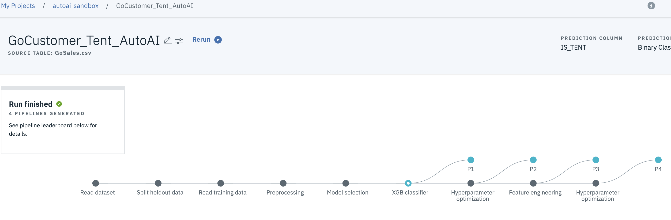
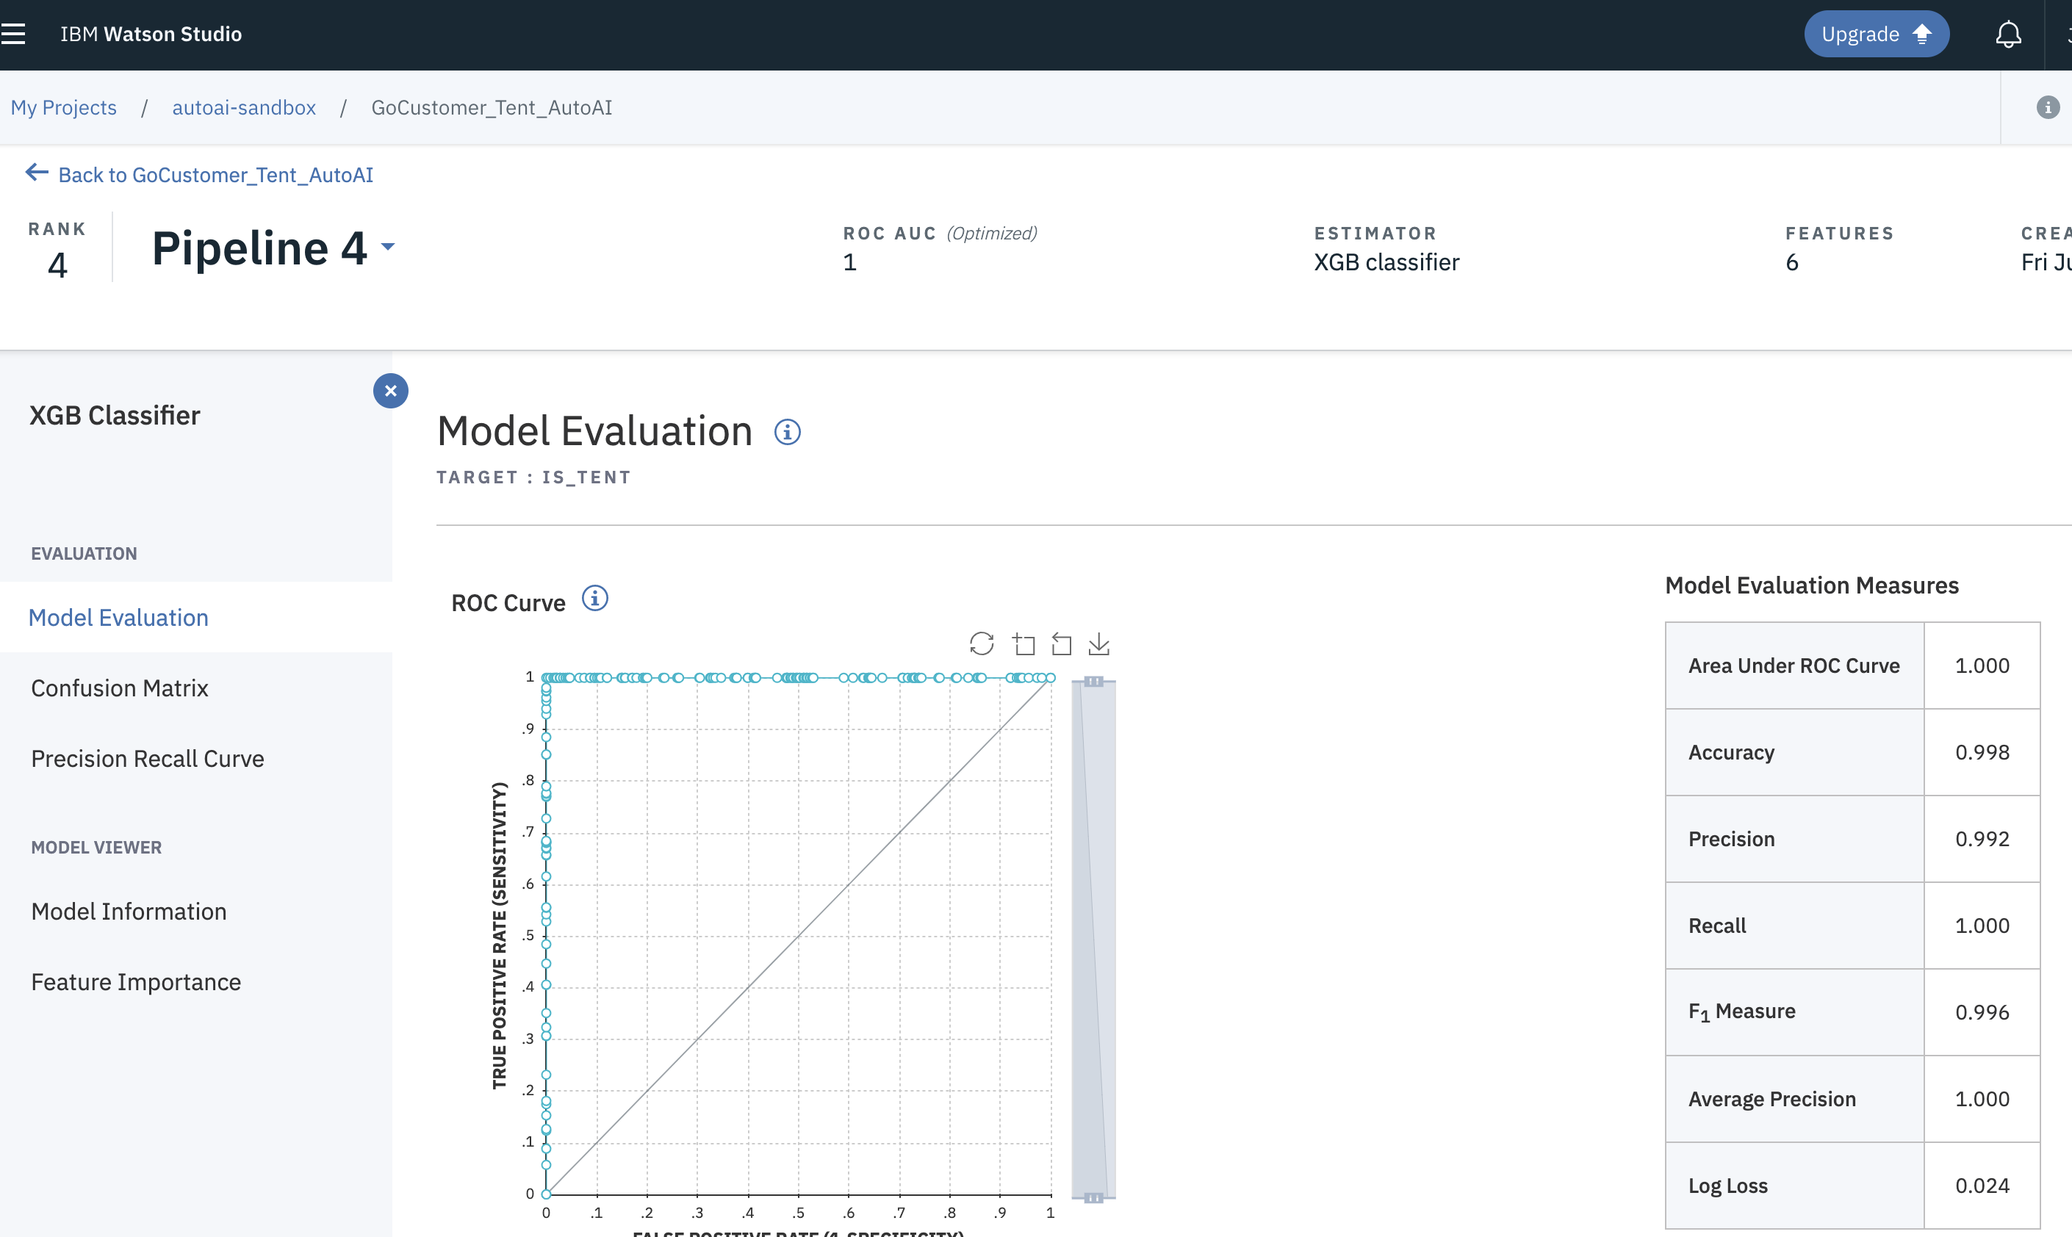
AutoAI: Pipelines
Builds models using sklearn
4 pipelines per estimator
Baseline sklearn estimator
HPO optimized estimator
Feature engineering
Feature engineering + HPO
The leaderboard contains model pipelines ranked by cross-validation scores (defaults = AUC score, Accuracy, and RMSE)
Notes:
AUC for ROC – Binary classification, Accuracy for multiclass classification, RMSE for regression

Slide 19
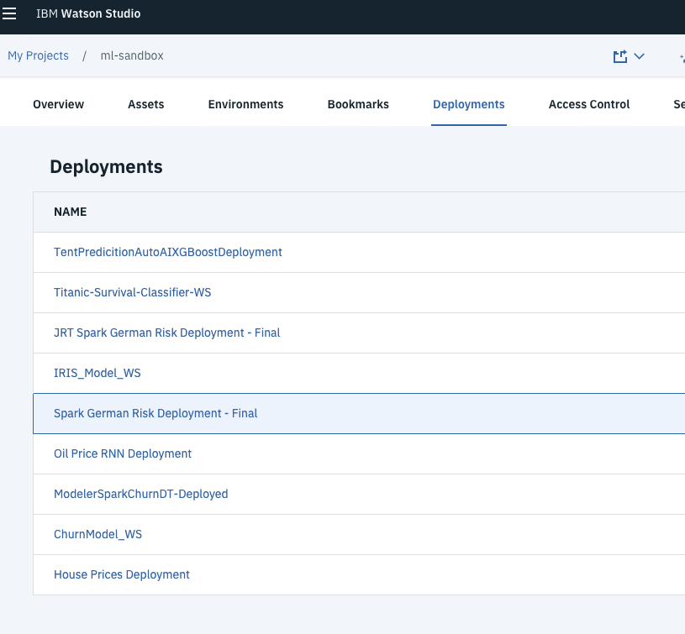
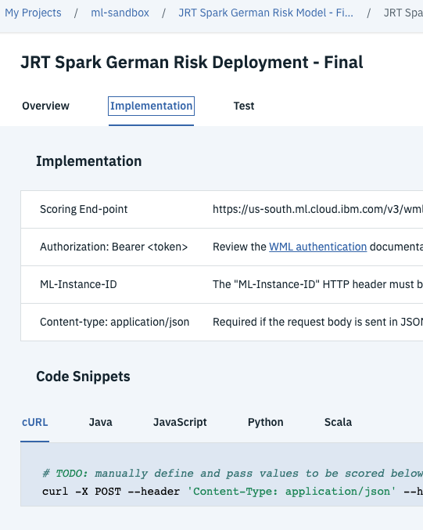
Deploying Models
Watson Machine Learning can host model (creates scoring endpoint)
Deployments via Python Client, REST API, Watson Studio GUI
Online web service
Batch
CoreML
Deploy models directly or Python functions to encapsulate model + logic
Preprocessing data, error handling, custom model orchestration, etc.

Slide 20

Thank You
Binu Midhun
Email: bmidhun1@in.ibm.com
Twitter: @binu_midhun

